Slide 1

SPARK

Slide 2
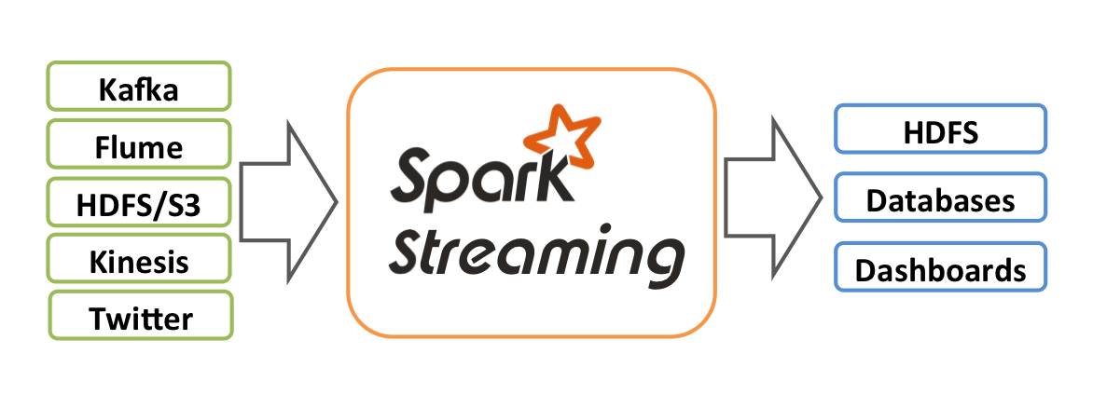
CONTENTS
Introduction to Spark Streaming
Spark Engine
Sending data stream from Kafka to Spark

Slide 3
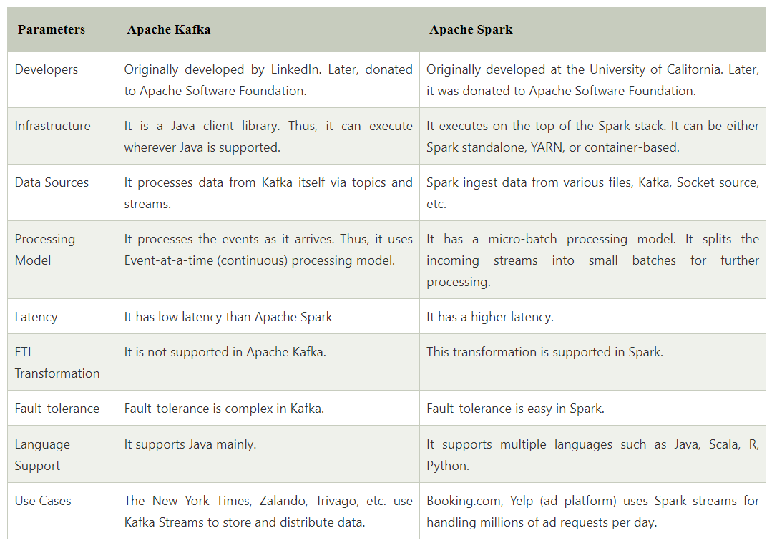

Slide 4
Introduction to Spark Streaming
A data stream is an unbounded sequence of data arriving continuously. S
treaming divides continuously flowing input data into discrete units for further processing. Stream processing is low latency processing and analyzing of streaming data.
Spark Streaming was added to Apache Spark in 2013, an extension of the core Spark API that provides scalable, high-throughput and fault-tolerant stream processing of live data streams.

Slide 5
Data ingestion can be done from many sources like Kafka, Apache Flume, Amazon Kinesis or TCP sockets and processing can be done using complex algorithms that are expressed with high-level functions like map, reduce, join and window.
Finally, processed data can be pushed out to filesystems, databases and live dashboards.
Live input data streams is received and divided into batches by Spark streaming, these batches are then processed by the Spark engine to generate the final stream of results in batches.

Slide 6
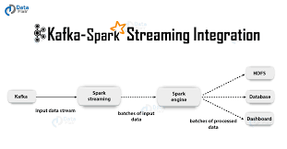
Its key abstraction is Apache Spark Discretized Stream or, in short, a Spark DStream, which represents a stream of data divided into small batches.
DStreams are built on Spark RDDs, Spark’s core data abstraction.
This allows Streaming in Spark to seamlessly integrate with any other Apache Spark components like Spark MLlib and Spark SQL.

Slide 7
Need for Streaming in Apache Spark
To process the data, most traditional stream processing systems are designed with a continuous operator model, which works as follows:
Streaming data is received from data sources (e.g. live logs, system telemetry data, IoT device data, etc.) into some data ingestion system like Apache Kafka, Amazon Kinesis, etc.
The data is then processed in parallel on a cluster.
Results are given to downstream systems like HBase, Cassandra, Kafka, etc.

Slide 8
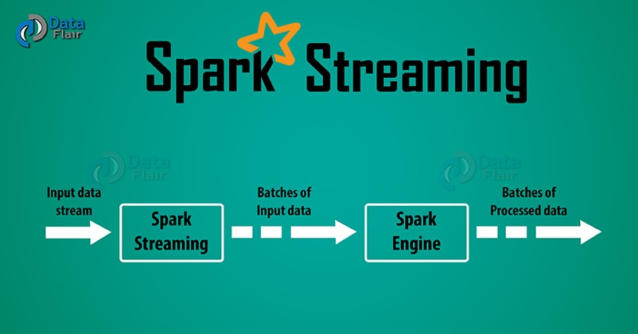

Slide 9
There is a set of worker nodes, each of which runs one or more continuous operators.
Each continuous operator processes the streaming data one record at a time and forwards the records to other operators in the pipeline.
Data is received from ingestion systems via Source operators and given as output to downstream systems via sink operators.

Slide 10
Continuous operators are a simple and natural model. However, this traditional architecture has also met some challenges with today’s trend towards larger scale and more complex real-time analytics:-
a) Fast Failure and Straggler Recovery
In real time, the system must be able to fastly and automatically recover from failures and stragglers to provide results which is challenging in traditional systems due to the static allocation of continuous operators to worker nodes.

Slide 11
b) Load Balancing
In a continuous operator system, uneven allocation of the processing load between the workers can cause bottlenecks. The system needs to be able to dynamically adapt the resource allocation based on the workload.
c) Unification of Streaming, Batch and Interactive Workloads
In many use cases, it is also attractive to query the streaming data interactively, or to combine it with static datasets (e.g. pre-computed models).
This is hard in continuous operator systems which does not designed to new operators for ad-hoc queries.

Slide 12
This requires a single engine that can combine batch, streaming and interactive queries.
d) Advanced Analytics with Machine learning and SQL Queries
Complex workloads require continuously learning and updating data models, or even querying the streaming data with SQL queries.
Having a common abstraction across these analytic tasks makes the developer’s job much easier.

Slide 13
Why Streaming in Spark?
Batch processing systems like Apache Hadoop have high latency that is not suitable for near real time processing requirements.
Processing of a record is guaranteed by Storm if it hasn’t been processed, but this can lead to inconsistency as repetition of record processing might be there.
The state is lost if a node running Storm goes down.

Slide 14
In most environments, Hadoop is used for batch processing while Storm is used for stream processing that causes an increase in code size, number of bugs to fix, development effort, introduces a learning curve, and causes other issues.
This creates the difference between Big data Hadoop and Apache Spark.
Spark Streaming helps in fixing these issues and provides a scalable, efficient, resilient, and integrated (with batch processing) system.
Spark has provided a unified engine that natively supports both batch and streaming workloads.
Spark’s single execution engine and unified Spark programming model for batch and streaming lead to some unique benefits over other traditional streaming systems.

Slide 15
Key reason behind Spark Streaming’s rapid adoption is the unification of disparate data processing capabilities.
This makes it very easy for developers to use a single framework to satisfy all the processing needs.
Furthermore, data from streaming sources can combine with a very large range of static data sources available through Apache Spark SQL.
To address the problems of traditional stream processing engine, Spark Streaming uses a new architecture called Discretized Streams that directly leverages the rich libraries and fault tolerance of the Spark engine.

Slide 16
Goals of Spark Streaming
This architecture allows Spark Streaming to achieve the following goals:
a) Dynamic load balancing
b) Fast failure and straggler recovery
c) Unification of batch, streaming and interactive analytics
d) Advanced analytics like machine learning and interactive SQL
e) Performance

Slide 17
How does Spark Streaming works?
In Spark Streaming divide the data stream into batches called DStreams, which internally is a sequence of RDDs. The RDDs process using Spark APIs, and the results return in batches.
Spark Streaming provides an API in Scala, Java, and Python. The Python API recently introduce in Spark 1.2 and still lacks many features.
Spark Streaming maintains a state based on data coming in a stream and it call as stateful computations.

Slide 18
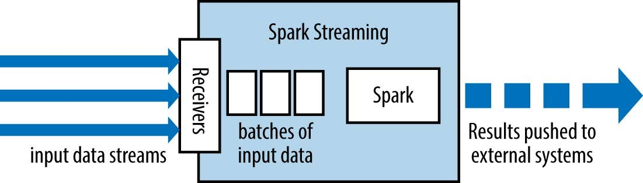
It also allows window operations (i.e., allows the developer to specify a time frame to perform operations on the data that flows in that time window).
There is a sliding interval in the window, which is the time interval of updating the window.

Slide 19
Spark Streaming Sources
Every input DStream (except file stream) associate with a Receiver object which receives the data from a source and stores it in Spark’s memory for processing.
There are two categories of built-in streaming sources:
Basic sources – These are the sources directly available in the StreamingContext API. Examples: file systems, and socket connections.
Advanced sources – Sources like Kafka, Flume, Kinesis, etc. are available through extra utility classes. These require linking against extra dependencies.

Slide 20
There are two types of receivers base on their reliability:
Reliable Receiver – A reliable receiver is the one that correctly sends an acknowledgment to a source when the data receives and stores in Spark with replication.
Unreliable Receiver – An unreliable receiver does not send an acknowledgment to a source. This we can use for sources when one does not want or need to go into the complexity of acknowledgment.

Slide 21
Spark Engine
The Data Integration Service can use the Spark engine on a Hadoop cluster to run Model repository mappings.
To run a mapping on the Spark engine, the Data Integration Service sends a mapping application to the Spark executor. The Spark executor submits the job to the Hadoop cluster to run.
The following image shows how a Hadoop cluster processes jobs sent from the Spark executor:

Slide 22
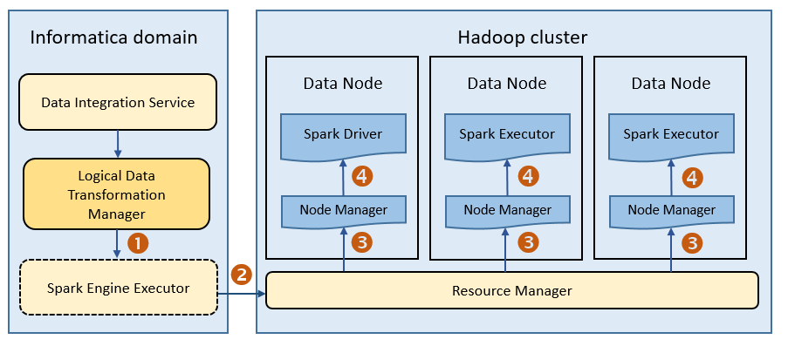

Slide 23
The following events occur when Data Integration Service runs a mapping on the Spark engine:
The Logical Data Transformation Manager translates the mapping into a Scala program, packages it as an application, and sends it to the Spark executor.
The Spark executor submits the application to the Resource Manager in the Hadoop cluster and requests resources to run the application.
The Resource Manager identifies the Node Managers that can provide resources, and it assigns jobs to the data nodes.
Driver and Executor processes are launched in data nodes where the Spark application runs.

Slide 24

Sending data stream from Kafka to Spark
Spark Streaming integration with Kafka allows a parallelism between partitions of Kafka and Spark along with a mutual access to metadata and offsets.
The connection to a Spark cluster is represented by a Streaming Context API which specifies the cluster URL, name of the app as well as the batch duration. This looks as follows:

Slide 25
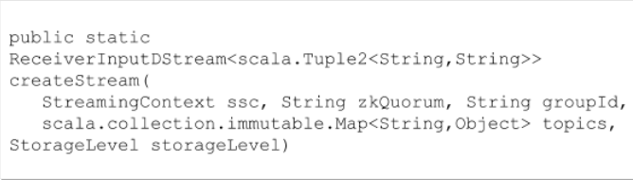
To connect a Kafka cluster to Spark Streaming, KafkaUtils API is used to create an input stream to fetch messages from Kafka. This can be represented as:

Slide 26
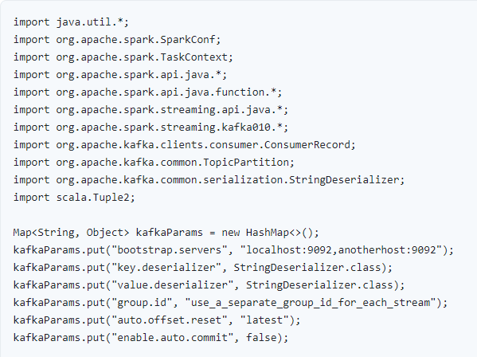
A direct stream can also be created for an input stream to directly pull messages from Kafka. This can be implemented through the following code:

Slide 27
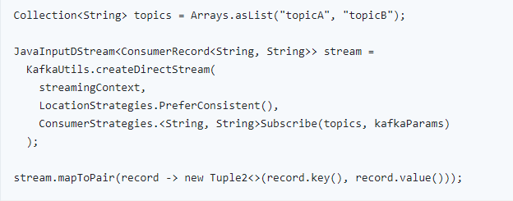
With these commands to fetch data, you can follow some simple steps to initiate integration between Spark Streaming and Kafka:

Slide 28
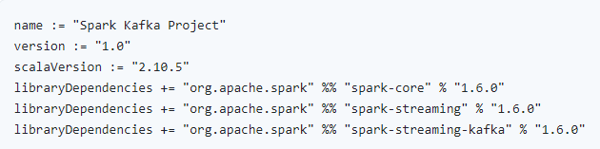
Step 1: Build a Script
You need to start out by building a script to specify the application details and all library dependencies. “build.sbt” can be used to execute this and download the necessary data required for compilation and packaging of the application.
As per your dependencies your code will look something like this:

Slide 29
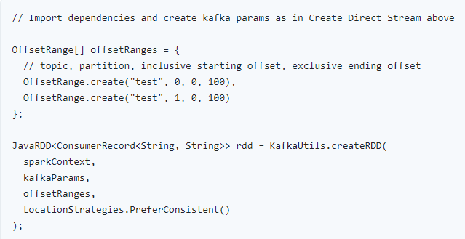
Step 2: Create an RDD
Within this method, you can create an RDD to introduce the offset ranges and import dependencies. This will also specify topic portioning and other parameters that require correspondence.

Slide 30
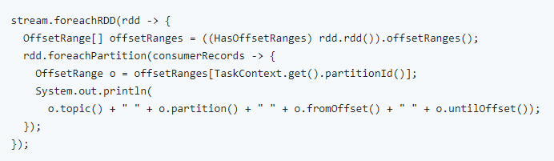
Step 3: Obtain and Store Offsets
The offset values need to be obtained and stored to be able to integrate it at the desired stage. For this, the offset range per partition can be defined as follows:

Slide 31
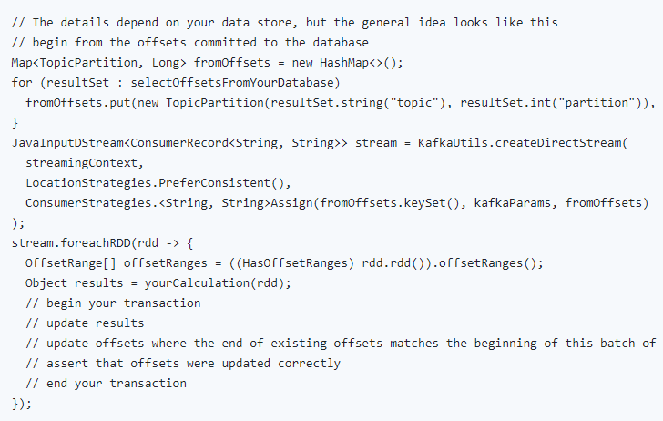
For transaction based data, some additional implementations need to be made to avoid duplication of datasets. This data can be represented as following depending on what data you are dealing with:

Slide 32
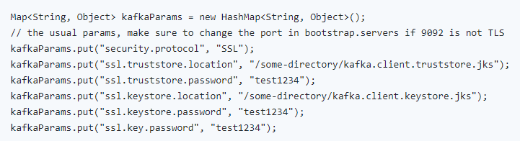
Step 4: Implementing SSL Spark Communication
Using the code below you can implement an SSL connection between Kafka and Spark brokers. This can help ensure that the integration is secure and protected against any third-party infiltrations, data leaks or losses incurred in the process.

Slide 33

Step 5: Compile and Submit to Spark Console
Finally, to launch the Spark application, you need to compile and submit the package. (spark-submit).The sbt package command can be run to compile and package the application file which can then be submitted using the following command:

Slide 34
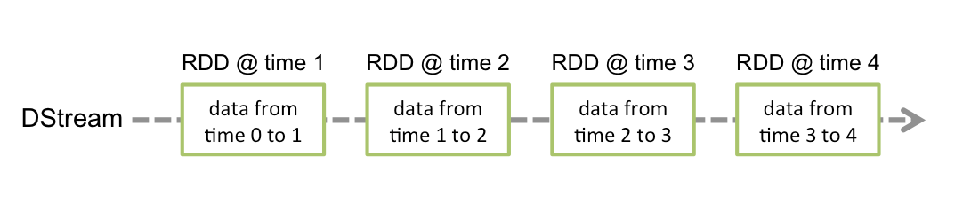
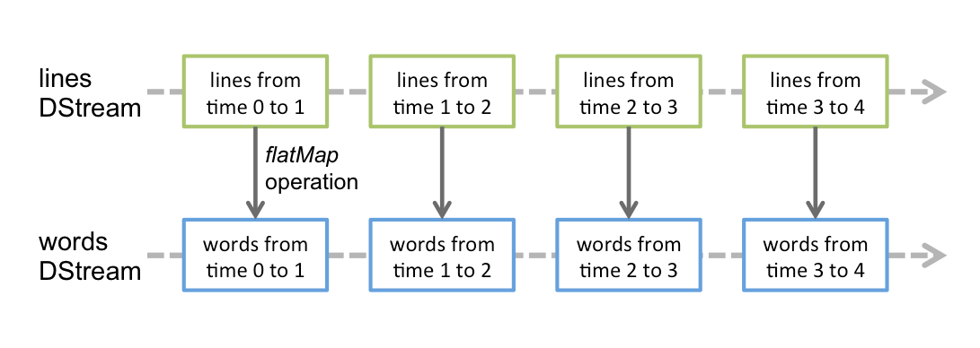
Following these steps, you can successfully initiate an integration between Spark Streaming and Kafka, and, thus, reap the twin-benefits of both APIs for your real-time data streaming and stream processing requirements.

Slide 35
END OF SESSION
Q&A

